Slide 1





































Name of Hospital:
Protocol Number:
Informed Assent Form A
Version:
Date:
Cover page
“{name of investigational product}”
～What’s a clinical trial?～
We are currently looking for people to participate in a “clinical trial.”
We will be checking to see what happens to your body during the clinical trial.
After the clinical trial proves that {name of the IP} is safe and works well,
it can be used to help many patients.
Name of your doctor： ＿＿＿＿＿＿＿＿＿＿＿＿
Name of your clinical research coordinator：＿＿＿＿＿＿＿＿

Slide 2




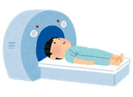
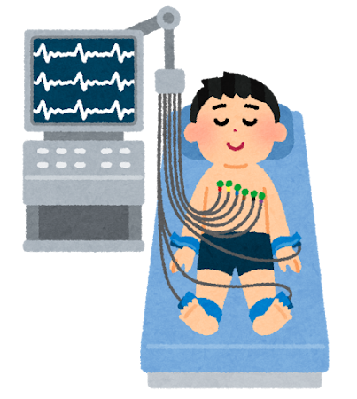


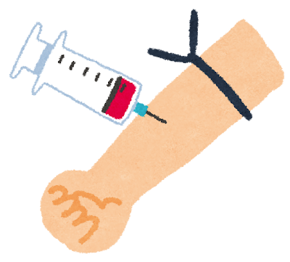











Name of Hospital:
Protocol Number:
Informed Assent Form A
Version:
Date:
※Primarily matters specific
to individual clinical trials
What to Do during the Clinical Trial
What You Will Do at the Hospital
Receive the following measurements and tests:
Height
Weight
Blood pressure
Body temperature
Blood test
Urine test
Have pictures of
the inside of
your body taken
Take a
heart exam
Stay overnight
at the hospital
for blood tests
What You Will Do at Home
What You Need to Remember
To take “｛name of the IP｝”
（2times a day）
Keep a diary
Don’t eat anything on the day you visit the hospital

Slide 3







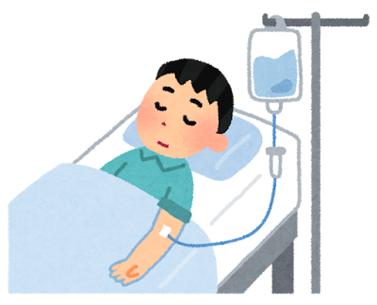












Name of Hospital:
Protocol Number:
Informed Assent Form A
Version:
Date:
※Mainly common matters for a clinical trial
Things That Might Happen
If you feel sick, the doctors at the hospital will check you.
→
Catch a cold
Itching goes away
Get a headache
Feel sick
Ask and Discuss
Anything You Want
If you decide not to take part in this trial,
you can quit at any time.
We will give you other treatments to help you feel better.
Please think carefully whether you wish to take part.
Your decision is very important.
Doctors
Agree
As before
“｛name of the IP｝”
No
Family member
Clinical research
coordinator

Slide 4
Name of Hospital:
Protocol Number:
Informed Assent Form A
Version:
Date:
Letter of Assent
Hospital copy
I have learned everything I want to know about {name of an investigational product} and agree to take part in this clinical trial.
Your name |  | Date of your decision
 |  | (year) | (month) | (day)
Doctor’s name |  | Explanation date
 |  | (year) | (month) | (day)
Clinical research coordinator’s name |  | Explanation date
 |  | (year) | (month) | (day)

Slide 5
Name of Hospital:
Protocol Number:
Informed Assent Form A
Version:
Date:
Letter of Assent
Copy
(clinical trial)
I have learned everything I want to know about {name of an investigational product} and agree to take part in this clinical trial.
Your name |  | Date of your decision
 |  | (year) | (month) | (day)
Doctor’s name |  | Explanation date
 |  | (year) | (month) | (day)
Clinical research coordinator’s name |  | Explanation date
 |  | (year) | (month) | (day)

Slide 6
Name of Hospital:
Protocol Number:
Informed Assent Form A
Version:
Date:
Letter of Assent
Patient copy
I have learned everything I want to know about {name of an investigational product} and agree to take part in this clinical trial.
Your name |  | Date of your decision
 |  | (year) | (month) | (day)
Doctor’s name |  | Explanation date
 |  | (year) | (month) | (day)
Clinical research coordinator’s name |  | Explanation date
 |  | (year) | (month) | (day)

